Slide 1

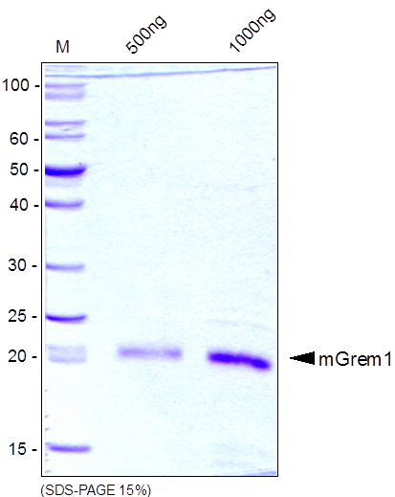
Reliatech GmbH
Recombinant mouse Gremlin-1 (Grem1)
(Cat #M30-025)
Fig. 1: SDS-PAGE analysis of recombinant mouse Gremlin-1 (Grem1) derived from E. coli. Samples were loaded in 15% SDS-polyacrylamide gel under reducing conditions and stained with Coomassie blue.
http://www.reliatech.de / orders@reliatech.de

